Slide 1

How I-Corps helps us commercialize technology

Slide 2
What we’re going to talk about
Best practices for commercializing new technology
Real stories about I-Corps projects
UARF resources that are free to UA grad students

Slide 3
Best Practices for Commercializing New Technology

Slide 4
We all make assumptions
What people want
Why people want something
What the most important problems, features and benefits are

Slide 5
What is customer discovery?
Talking to actual people to learn something you wouldn’t otherwise know about the:
People who would benefit from your research/scholarship
Problems and needs they have
How your work could be used in outside academia

Slide 6
How to do customer discovery
(aka the I-Corps method)
Goal: transform assumptions into facts
Hypothesize
Test – Interviews
Assess & Analyze
Adjust & Pivot
Notes:
Gain insights to change the canvas
Who your customers are?
What their pains and needs are?
What product can address pains/gains?

Slide 7
Real Stories about I-Corps projects

Slide 8
How to do customer discovery
(aka the I-Corps method)
Goal: transform assumptions into facts
Hypothesize
Test – Interviews
Assess & Analyze
Adjust & Pivot
Notes:
Gain insights to change the canvas
Who your customers are?
What their pains and needs are?
What product can address pains/gains?

Slide 9
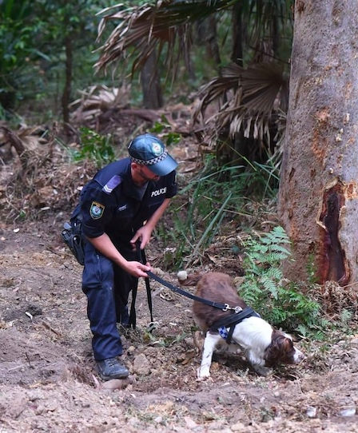
Who wants to find a dead body?
NSF I-Corps gave us a solid understanding of our product opportunity and helped us discover our first customers.
– Chris Matney, I-Corps Mentor

Slide 10
How to do customer discovery
(aka the I-Corps method)
Goal: transform assumptions into facts
Hypothesize
Test – Interviews
Assess & Analyze
Adjust & Pivot
Notes:
Gain insights to change the canvas
Who your customers are?
What their pains and needs are?
What product can address pains/gains?

Slide 11
What is the problem?
I-Corps really opened my eyes to a lot of different opportunities. It put me in front of potential customers, stakeholders, and even potential investors in some cases. From that perspective, it really changed my mindset in a lot of areas.
– Isaiah Kaiser, UA Ph.D. student
-Dressing changes!
-Healing time!
-Nothing.
-Cost!
-Pain!

Slide 12
How to do customer discovery
(aka the I-Corps method)
Goal: transform assumptions into facts
Hypothesize
Test – Interviews
Assess & Analyze
Adjust & Pivot
Notes:
Gain insights to change the canvas
Who your customers are?
What their pains and needs are?
What product can address pains/gains?

Slide 13
Communicating better

Slide 14
The bottom line
I-Corps provides a truly unique combination of a strong educational opportunity for students and a meaningful way to connect with industry. We're proud that more than 30 faculty members from College of Engineering and Polymer Science participated in I-Corps and hope to see many more participate in the future.
– Craig Menzemer, Dean, UA College of Engineering and Polymer Science

Slide 15
Free Resources Available through UARF

Slide 16
About UARF
Over the past 5 years
  300 teams and startups assisted
  2,000 individuals participating in UARF programming
  12,000 customers interviewed
  $25M in tech commercialization funding raised

Slide 17
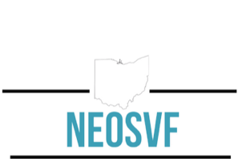
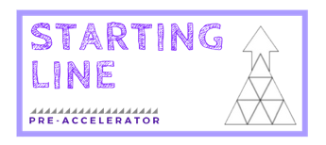

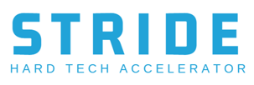
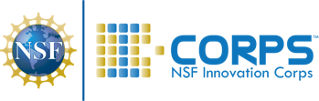

UARF’s Key Programs
Customer Discovery
Market UA Patents
Accelerate Hard Tech Startups
Build Prototypes
Students Fund Startups
Pitch Resource Providers
Explore Business Ideas
License
UA IP
Engage UA Student Interns to Support Process

Slide 18
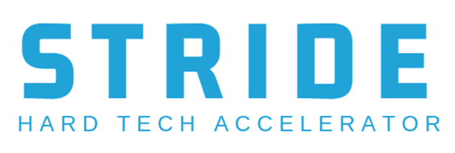
Free UARF Resources
Quick process to assess a business idea
Online, self-paced, about 5 hours
Perfect for students
Intro to customer discovery
Experiential learning for students
Apply it to your classroom
Startup accelerator program
Tailored to scientists and engineers
Teaches business skills

Slide 19
Thank you!
Elyse Ball
eball@uakron.edu
UAkronUARF.com

